Slide 1
LAB 4

Slide 2
TODAY TASKS
1. Making a Milestone
A milestone is a task with zero duration; it is generally used for tracking purposes
2. Entering Recurring Tasks
3. Creating a basic WORK BREAKDOWN STRUCTURE (WBS)
Entering the List of Tasks
Creating a unique WBS Code
4. Network Diagram
5. Assigning Predecessors to Tasks

Slide 3
Possible relationships (links) among different tasks are:
● Finish-to-Start (FS) – Default, commonly used
● Start-to-Start (SS) (having same start dates)
● Finish-to-Finish (FF) (having same finish dates)
● Start-to-Finish (SF) (rarely used)

Slide 4
Double‐click the task that needs the predecessors. Select the Predecessors & enter the ID for the task on which selected task is dependent & then select the type of dependency needed.

Slide 5
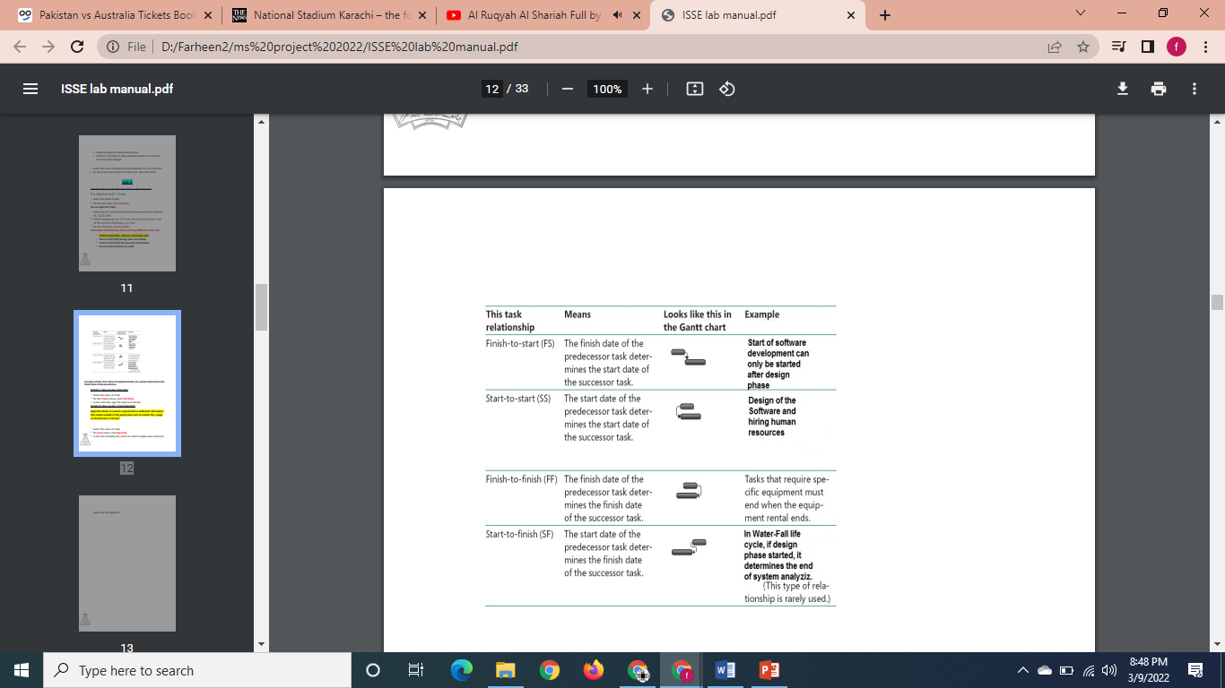

Slide 6
Project Elements
Function
Project
Management Activity
Duration – Project Life
Risk Management
Configuration
Management
Function
Activity
Activity
Activity
Activity
Activity
Activity
Activity
– An element of work with expected duration, cost, and resources
Task
Task
Task
Lowest level of work
No shown on WBS

Slide 7
Work Breakdown Structure: WBS
Hierarchical list of project’s work activities
List of Activities, not Things
2 Formats
Outline (indented format)
Graphical Tree (Organizational Chart)
Uses a decimal numbering system
– e.g., 3.1.5
0 is typically top level
Includes
Development, management, and project support activities
Shows “is contained in” relationships
Does not show dependencies or durations

Slide 8
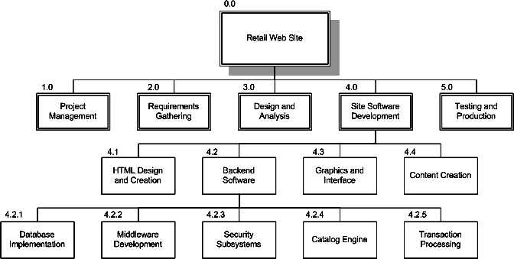
WBS Chart Example

Slide 9
WBS Outline Example
0.0 Retail Web Site
1.0 Project Management
2.0 Requirements Gathering
3.0 Analysis & Design
Site Software Development
HTML Design and Creation
Backend Software
Database Implementation
Middleware Development
Security Subsystems
Catalog Engine
Transaction Processing
Graphics and Interface
Content Creation
5.0 Testing and Production

Slide 10
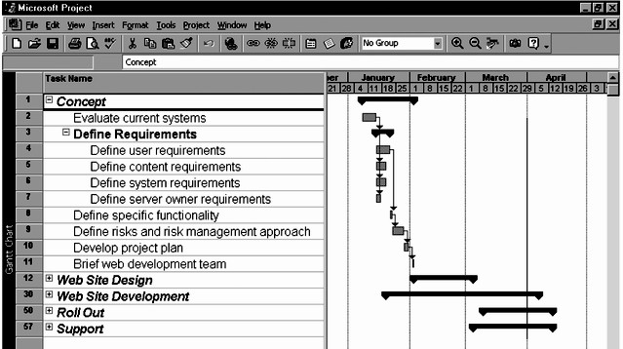
Outline WBS w/Gantt

Slide 11
Why do we require
a Work Breakdown Structure?
To organize the work to be done
To illustrate the work to be done
To assure that all necessary work has been identified
To divide the work into small, well defined tasks
To facilitate planning, estimating and scheduling of the project
To provide a basis for data monitoring and historical data collection
To identify contractual tasks and deliverables

Slide 12
Why WBS
Cost estimating
To make sure all activities get estimated
To make sure that each element of the estimate corresponds to a necessary activity
To “roll up” costs of individual elements into total costs for sub-elements and for the system as a whole
Cost accounting
To assign work and “charge it” to appropriate cost centers based on specific WBS elements
To determine the actual cost of each element
Schedule performance
To monitor which activities are complete
To measure project progress

Slide 13
WBS Types
Process WBS
a.k.a. Activity-oriented
e.g., Requirements, Analysis, Design, Testing
Typically used by PM
Product WBS
a.k.a. Entity-oriented
e.g., Financial engine, Interface system, DB
Typically used by engineering manager

Slide 14
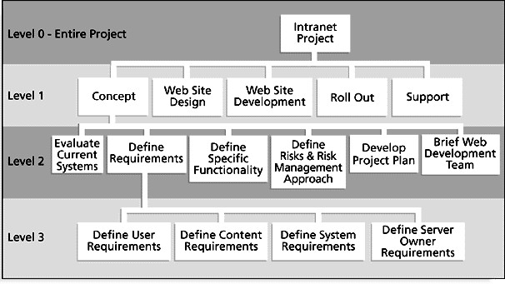
Process WBS

Slide 15
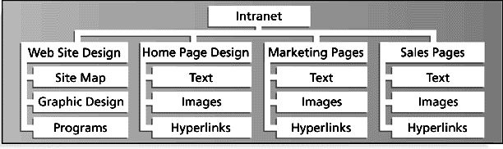
Product WBS

Slide 16
WBS Types
Less frequently used alternatives
Organizational WBS
Research, Product Design, Engineering, Operations
Can be useful for highly cross-functional projects
Geographical WBS
Can be useful with distributed teams
ISB team, NYC team, MAN team

Slide 17
Work Packages
Generic term for discrete tasks with definable end results
Typically the “leaves” on the tree
The “one-to-two” rule
Often at: 1 or 2 persons for 1 or 2 weeks
Basis for monitoring and reporting progress
Can be tied to budget items (charge numbers)
Resources (personnel) assigned
For software development project correspond to the lowest identifiable objects or modules to be created in a deliverable system

Slide 18
WBS Techniques
Top-Down
Bottom-Up
Analogy
Rolling Wave
1st pass: go 1-3 levels deep
Gather more requirements or data
Add more detail later
Post-its on a wall

Slide 19
WBS Techniques - Top-down
Start at highest level
Systematically develop increasing level of detail
Best if
The problem is well understood
Technology and methodology are not new
This is similar to an earlier project or problem
But is also applied in majority of situations

Slide 20
WBS Techniques - Bottom-up
Start at lowest level tasks
Aggregate into summaries and higher levels
Cons
Time consuming
Needs more requirements complete
Pros
Detailed

Slide 21
WBS Techniques - Analogy
Base WBS upon that of a “similar” project
Use a template
Analogy also can be estimation basis
Pros
Based on past actual experience
Cons
Needs comparable project

Slide 22
WBS Techniques - Brainstorming
Generate all activities you can think of that need to be done
Group them into categories
Both Top-down and Brainstorming can be used on the same WBS
Remember to get the people who will be doing the work involved

